Slide 1
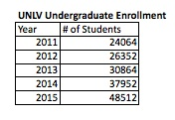
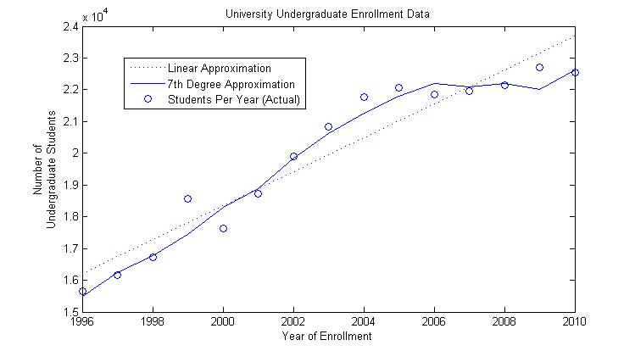
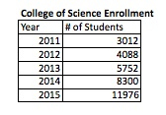
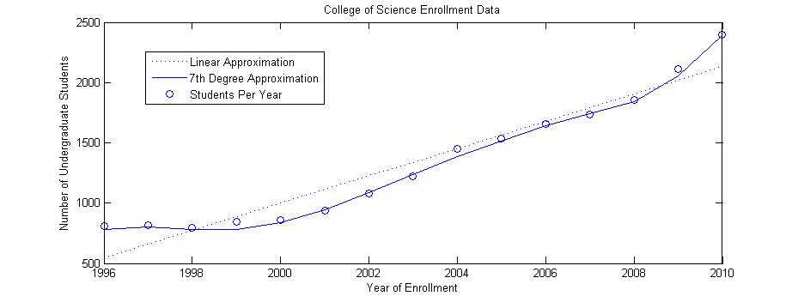
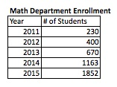
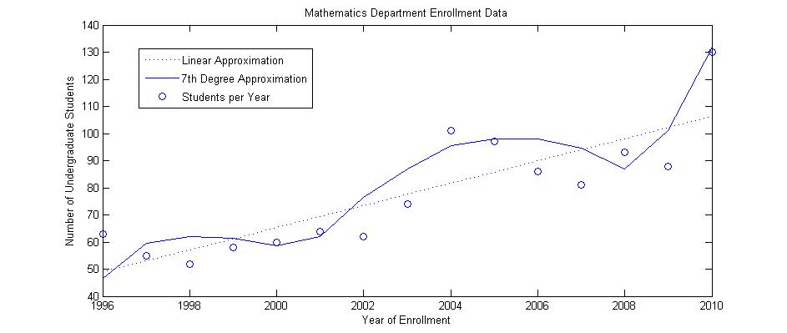

UNLV Enrollment Forecasting
Sabrina Beckman, Stefan Cline, Dr. Monika Neda
Department of Mathematical Sciences, University of Nevada Las Vegas - UNLV
Introduction
Enrollment Data
Undergraduate Student
Enrollment Predictions
Data Fitting Results
A continuing problem for university administrations is managing admissions so that the freshman class entering in the fall is neither too large nor to small. Least-squares ﬁts to historical data is often used for forecasting future numbers. In our project we will model enrollment data for the University of Nevada, Las Vegas, the College of Science, along with the Department of Mathematical Sciences.
UNLV Undergraduate Enrollment
What does Least-Squares mean?
Consider the linear system Ax = b where A is (m x n), with m>n. This system is overdetermined and often does not have a solution. If x is a vector in R^{n} , then the vector r = Ax−b is called a residual vector. A vector x* in R^{n} that yields the smallest possible residual vector is called a least-squares solution to Ax=b. More precisely, x* is a least-squares solution to:
Ax=b if ||Ax*-b|| ≤ ||Ax-b||, for all x in R^{n}
Least- Squares Theorem, [1].
Consider the (m x n) system Ax= b.
the associated system A^{T}Ax= A^{T}b is always consistent.
The least squares solutions of Ax=b are precisely the solutions of A^{T}Ax= A^{T}b
The least-squares solution is unique if and only if A has rank n.
The least-squares method rule is: “The degree of the least-squares ﬁt should be about half the number of data points.” Our data consists of 15 points, ranging from year 1996 to 2010. Each graph, from the Numerical Results section, will show the linear approximation, and then the 7th degree polynomial approximation (because that is about half the number of data points).
UNLV College of Science Undergraduate Enrollment
UNLV Department of Mathematical Sciences Undergraduate Enrollment
Investigation of Numerical Error
We used the given data up until year 2008 and then tried to predict the UNLV enrollment for 2009 and 2010 using linear approximation and than the 6th degree polynomial approximation (since we were now only working with 12 data points). Our actual 2009 enrollment was 22,708 students. The 6th order polynomial approximation predicted it at 22,688 students, a 0.09 percent error. The linear approximation predicted it at 23,749 students, a 4.58 percent error. Our actual 2010 enrollment was 22,538 students. The 6th order polynomial approximation predicted it at 23,840 students, a 5.78 percent error. The linear approximation predicted it at 24,350 students, a 8.04 percent error. For both years, the 6th order polynomial approximation is more accurate.
The 7th order polynomial approximation was used
to get the above predictions.
Conclusions and Future Directions
References
Our results show an overall increase in the undergraduate student enrolments. The investigation of the numerical error shows that the higher order approximation gives a better prediction for the near future.
Future studies will be connected to other data fitting methods, their comparison, and applied to other data sets.
[1] Lee W. Johnson, R. Dean Riess, and Jimmy T. Arnold, “Introduction to Linear Algebra”, 5th ed., Pearson Education, 2002.
[2] “Reports and Resources”, The Oﬃce of Institutional Analysis and Planning (IAP), University of Nevada Las Vegas, http://ir.unlv.edu/iap/.
Acknowledgements
We thank Janet Reiber, Director of College of Sciences Advising Center, and the Office of Institutional Analysis and Planning (IAP) for help with the enrollment data. We also thank to Department of Mathematical Sciences for the provided funds.

